Slide 1

Real Time Applications with WebSockets and SignalR for distributed Messaging from Visual Foxpro
Rick Strahl
West Wind Technologies
west-wind.com
weblog.west-wind.com
session materials: https://bitbucket.org/RickStrahl/swfox16_signalr

Slide 2
Beyond the Request and Response Web
Traditional Web Apps are One to One
Transactional
Request / Response
Can be Async but limited
Most of what we see on the Web today is 'Traditional HTTP'
Web Sockets and 'Real-Time Web'
Push Technology
Peer to Peer
Multi-casting to many simultaneous clients
Connected

Slide 3
Traditional Http Applications One to One Connections
Web Client
Request
Web Server
Receives request
Processes message
Sends a Response
Response
Request: Client makes request for data
> Server processes request <
Response: Server sends HTTP result

Slide 4
Traditional Http Applications
Transactional
Request / Response Pattern
Client sends a request (and possibly data)
Server responds with an HTTP result
One to One
One client connects to One server
Response is always send to original sender
Almost all Web Interaction follows this Model
Static content (html pages)
Dyanamically generated Content (reports, stores)
Services and APIs
Limitations
Difficulty dealing with long requests
Polling only way to simulate server notifications

Slide 5
The Real Time Web: Web Sockets and SignalR
Socket connections over HTTP

Slide 6
Three Things:
Server Push
Peer to Peer
Multi-Casting

Slide 7

Server Push
Pushing Data to the Client
Allows server to send message to a connected client
Connections are always open and instant
Allows for direct notification of triggers on the server

Slide 8

Peer to Peer
Client to Client Communications
Interconnected applications
Any client can talk to any other
Individual clients or groups of clients

Slide 9

Multi-Casting
Hub and Spoke Model
Many clients (spokes), single server (hub)
Client can send to other clients
Client can send to many other clients
Central server acts as mediator

Slide 10

Creating SignalR Hubs and Clients
Some .NET Assembly Required

Slide 11
SignalR: One Hub - many Clients
SignalR Client
SignalR Client
SignalR Hub
runs on IIS receives and broadcasts messages
SignalR Client
SignalR Client
Publish: send message to Hub
> Hub broadcasts message <
Subscribe: listen for message

Slide 12
FoxPro and SignalR
Web Boundary
SignalR
Client
Invoke
FoxPro
Client
.NET
SignalR Client
SignalR Hub
runs on IIS receives and broadcasts messages
SignalR
Client
Callback
SignalR
Client

Slide 13
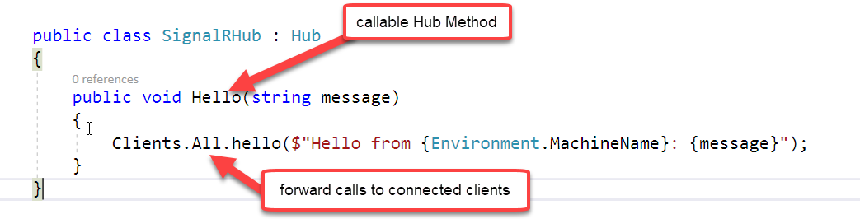
Create a SignalR Hub in .NET
New Web Project
Add New SignalR Hub to a Project
Startup Configuration
One or more HubClasses
Hub Implementation
Create Hub Class
Add methods that are remotely callable
Forward call using Client.All, Client.User, Clients.Group(s)

Slide 14
Create a SignalR Client
Create a Class Library
Create a SignalR Client
Start/Stop methods
Invoke Hub wrapper methods
Handle Hub Callback Messages
Life Cycle
Create Hub
Register Callback Handlers
Start the Hub
Invoke methods on the Hub
Wait for callbacks from the Hub
Stop the Hub

Slide 15
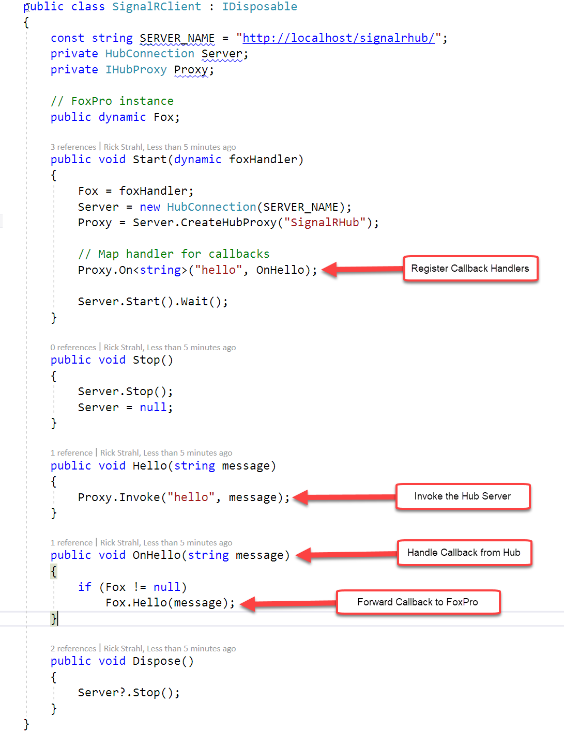

Slide 16
FoxPro Client To .NET SignalR
Use .NET as a Proxy
SignalR has a .NET Client
Create Client in .NET Code
Call .NET Client from FoxPro using wwDotnetBridge
Asynchronous Code
SignalR is async
You have to receive 'message events'
Passing a FoxPro Object to .NET
Pass a FoxPro object to .NET during initialization
.NET code calls FoxPro object when messages arrive

Slide 17
Client Targeting
Who are you calling?
Clients.All – all users
Clients.Group() – specific group
Clients.
Groups are Primary Separation Mechanism

Slide 18
Messaging Across Applications
Publisher
Subscribers
SignalR
Client
Web Store
Web Site
Notification Server
REST Service
SignalR Hub
receives and broadcasts messages
websockets
SignalR
Client
http
websockets
Direct access requires that the publisher keeps a WebSocket connection to the Socket Server
Using an intermediate service
removes the source server's requirement
to hold open connections
SignalR
Client

Slide 19
Review Application Scenarios
Peer to Peer
Send messages to other users in the system
One to one messaging
One to many (via groups)
Example: Private messaging between applications
Multi-cast
Send a message to many/all users
Example: Chat Application
Client to Server
Call a server – but asynchronous
Get called back via Notification
Server to Client
Server Push
Notifies client(s) when something interesting happens
Example: Order Notification in a Web Store

Slide 20
Thank you!
Resources
BitBucket: Source Code, White Paper and Slides https://bitbucket.org/RickStrahl/swfox16_signalr
Sample SignalR Site (up for a short while after SWFox17) http://signalrswf.west-wind.com
Contact Rick
@RickStrahl on Twitter
https://weblog.west-wind.com
https://west-wind.com/wconnect/weblog/
rstrahl@west-wind.com

